Slide 1
Ch 18 Cellular Manufacturing
Sections:
Part Families
Parts Classification and Coding
Production Flow Analysis
Cellular Manufacturing
Applications in Group Technology
Quantitative Analysis in Cellular Manufacturing
©2008 Pearson Education, Inc., Upper Saddle River, NJ. All rights reserved. This material is protected under all copyright laws as they currently exist.
No portion of this material may be reproduced, in any form or by any means, without permission in writing from the publisher. For the exclusive use of adopters of the book
Automation, Production Systems, and Computer-Integrated Manufacturing, Third Edition, by Mikell P. Groover.

Slide 2
Group Technology (GT) Defined
A manufacturing philosophy in which similar parts are identified and grouped together to take advantage of their similarities in design and production
Similarities among parts permit them to be classified into part families
  In each part family, processing steps are similar
The improvement is typically achieved by organizing the production facilities into manufacturing cells that specialize in production of certain part families
©2008 Pearson Education, Inc., Upper Saddle River, NJ. All rights reserved. This material is protected under all copyright laws as they currently exist.
No portion of this material may be reproduced, in any form or by any means, without permission in writing from the publisher. For the exclusive use of adopters of the book
Automation, Production Systems, and Computer-Integrated Manufacturing, Third Edition, by Mikell P. Groover.

Slide 3
Overview of Group Technology
Parts in the medium production quantity range are usually made in batches
Disadvantages of batch production:
  Downtime for changeovers
  High inventory carrying costs
GT minimizes these disadvantages by recognizing that although the parts are different, there are groups of parts that possess similarities
©2008 Pearson Education, Inc., Upper Saddle River, NJ. All rights reserved. This material is protected under all copyright laws as they currently exist.
No portion of this material may be reproduced, in any form or by any means, without permission in writing from the publisher. For the exclusive use of adopters of the book
Automation, Production Systems, and Computer-Integrated Manufacturing, Third Edition, by Mikell P. Groover.

Slide 4
Part Families and
Cellular Manufacturing
GT exploits the part similarities by utilizing similar processes and tooling to produce them
Machines are grouped into cells, each cell specializing in the production of a part family
  Called cellular manufacturing
Cellular manufacturing can be implemented by manual or automated methods
  When automated, the term flexible manufacturing system is often applied
©2008 Pearson Education, Inc., Upper Saddle River, NJ. All rights reserved. This material is protected under all copyright laws as they currently exist.
No portion of this material may be reproduced, in any form or by any means, without permission in writing from the publisher. For the exclusive use of adopters of the book
Automation, Production Systems, and Computer-Integrated Manufacturing, Third Edition, by Mikell P. Groover.

Slide 5
When to Use GT and
Cellular Manufacturing
The plant currently uses traditional batch production and a process type layout
  This results in much material handling effort, high in-process inventory, and long manufacturing lead times
The parts can be grouped into part families
  A necessary condition to apply group technology
  Each machine cell is designed to produce a given part family, or a limited collection of part families, so it must be possible to group parts made in the plant into families
©2008 Pearson Education, Inc., Upper Saddle River, NJ. All rights reserved. This material is protected under all copyright laws as they currently exist.
No portion of this material may be reproduced, in any form or by any means, without permission in writing from the publisher. For the exclusive use of adopters of the book
Automation, Production Systems, and Computer-Integrated Manufacturing, Third Edition, by Mikell P. Groover.

Slide 6
Problems in Implementing GT
Identifying the part families
  Reviewing all of the parts made in the plant and grouping them into part families is a substantial task
Rearranging production machines into GT cells
  It is time-consuming and costly to physically rearrange the machines into cells, and the machines are not producing during the changeover
©2008 Pearson Education, Inc., Upper Saddle River, NJ. All rights reserved. This material is protected under all copyright laws as they currently exist.
No portion of this material may be reproduced, in any form or by any means, without permission in writing from the publisher. For the exclusive use of adopters of the book
Automation, Production Systems, and Computer-Integrated Manufacturing, Third Edition, by Mikell P. Groover.

Slide 7
Part Family
A collection of parts that possess similarities in geometric shape and size, or in the processing steps used in their manufacture
Part families are a central feature of group technology
  There are always differences among parts in a family
  But the similarities are close enough that the parts can be grouped into the same family
©2008 Pearson Education, Inc., Upper Saddle River, NJ. All rights reserved. This material is protected under all copyright laws as they currently exist.
No portion of this material may be reproduced, in any form or by any means, without permission in writing from the publisher. For the exclusive use of adopters of the book
Automation, Production Systems, and Computer-Integrated Manufacturing, Third Edition, by Mikell P. Groover.

Slide 8
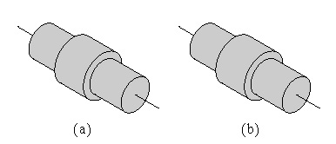
Part Families
Two parts that are identical in shape and size but quite different in manufacturing: (a) 1,000,000 units/yr, tolerance = ±0.010 inch, 1015 CR steel, nickel plate; (b) 100/yr, tolerance = ±0.001 inch, 18‑8 stainless steel
©2008 Pearson Education, Inc., Upper Saddle River, NJ. All rights reserved. This material is protected under all copyright laws as they currently exist.
No portion of this material may be reproduced, in any form or by any means, without permission in writing from the publisher. For the exclusive use of adopters of the book
Automation, Production Systems, and Computer-Integrated Manufacturing, Third Edition, by Mikell P. Groover.

Slide 9
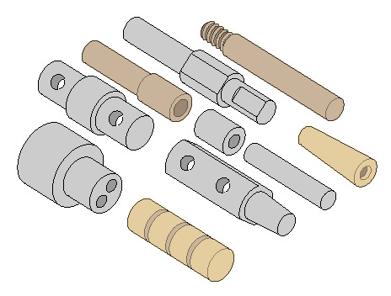
Part Families
Ten parts are different in size, shape, and material, but quite similar in terms of manufacturing
All parts are machined from cylindrical stock by turning; some parts require drilling and/or milling
©2008 Pearson Education, Inc., Upper Saddle River, NJ. All rights reserved. This material is protected under all copyright laws as they currently exist.
No portion of this material may be reproduced, in any form or by any means, without permission in writing from the publisher. For the exclusive use of adopters of the book
Automation, Production Systems, and Computer-Integrated Manufacturing, Third Edition, by Mikell P. Groover.

Slide 10
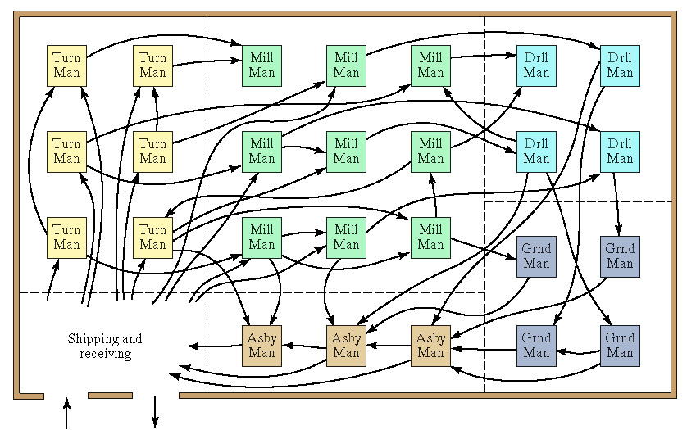
Traditional Process Layout
©2008 Pearson Education, Inc., Upper Saddle River, NJ. All rights reserved. This material is protected under all copyright laws as they currently exist.
No portion of this material may be reproduced, in any form or by any means, without permission in writing from the publisher. For the exclusive use of adopters of the book
Automation, Production Systems, and Computer-Integrated Manufacturing, Third Edition, by Mikell P. Groover.

Slide 11
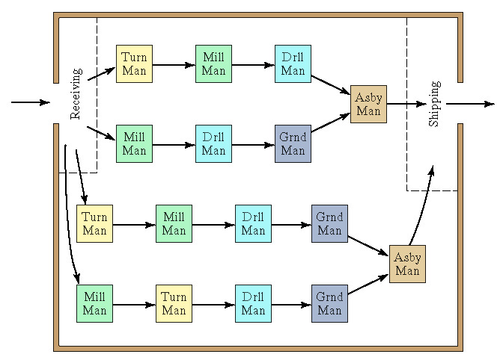
Cellular Layout Based on GT
Each cell specializes in producing one or a limited number of part families
©2008 Pearson Education, Inc., Upper Saddle River, NJ. All rights reserved. This material is protected under all copyright laws as they currently exist.
No portion of this material may be reproduced, in any form or by any means, without permission in writing from the publisher. For the exclusive use of adopters of the book
Automation, Production Systems, and Computer-Integrated Manufacturing, Third Edition, by Mikell P. Groover.

Slide 12
Ways to Identify Part Families
Visual inspection
  Using best judgment to group parts into appropriate families, based on the parts or photos of the parts
Parts classification and coding
  Identifying similarities and differences among parts and relating them by means of a coding scheme
Production flow analysis
  Using information contained on route sheets to classify parts
©2008 Pearson Education, Inc., Upper Saddle River, NJ. All rights reserved. This material is protected under all copyright laws as they currently exist.
No portion of this material may be reproduced, in any form or by any means, without permission in writing from the publisher. For the exclusive use of adopters of the book
Automation, Production Systems, and Computer-Integrated Manufacturing, Third Edition, by Mikell P. Groover.

Slide 13
Parts Classification and Coding
Identification of similarities among parts and relating the similarities by means of a numerical coding system
Most time consuming of the three methods
Must be customized for a given company or industry
Reasons for using a coding scheme:
  Design retrieval
  Automated process planning
  Machine cell design
©2008 Pearson Education, Inc., Upper Saddle River, NJ. All rights reserved. This material is protected under all copyright laws as they currently exist.
No portion of this material may be reproduced, in any form or by any means, without permission in writing from the publisher. For the exclusive use of adopters of the book
Automation, Production Systems, and Computer-Integrated Manufacturing, Third Edition, by Mikell P. Groover.

Slide 14
Features of Parts Classification and Coding Systems
Most classification and coding systems are based on one of the following:
  Part design attributes
  Part manufacturing attributes
  Both design and manufacturing attributes
©2008 Pearson Education, Inc., Upper Saddle River, NJ. All rights reserved. This material is protected under all copyright laws as they currently exist.
No portion of this material may be reproduced, in any form or by any means, without permission in writing from the publisher. For the exclusive use of adopters of the book
Automation, Production Systems, and Computer-Integrated Manufacturing, Third Edition, by Mikell P. Groover.

Slide 15
Part Design Attributes
Major dimensions
Basic external shape
Basic internal shape
Length/diameter ratio
Material type
Part function
Tolerances
Surface finish
©2008 Pearson Education, Inc., Upper Saddle River, NJ. All rights reserved. This material is protected under all copyright laws as they currently exist.
No portion of this material may be reproduced, in any form or by any means, without permission in writing from the publisher. For the exclusive use of adopters of the book
Automation, Production Systems, and Computer-Integrated Manufacturing, Third Edition, by Mikell P. Groover.

Slide 16
Part Manufacturing Attributes
Major process
Operation sequence
Batch size
Annual production
Machine tools
Cutting tools
Material type
©2008 Pearson Education, Inc., Upper Saddle River, NJ. All rights reserved. This material is protected under all copyright laws as they currently exist.
No portion of this material may be reproduced, in any form or by any means, without permission in writing from the publisher. For the exclusive use of adopters of the book
Automation, Production Systems, and Computer-Integrated Manufacturing, Third Edition, by Mikell P. Groover.

Slide 17
Coding Scheme Structures
Hierarchical structure (monocode)
  Interpretation of each successive digit depends on the value of the preceding digit
Chain-type structure (polycode)
  Interpretation of each symbol is always the same
  No dependence on previous digits
Mixed-code structure
  Combination of hierarchical and chain-type structures
©2008 Pearson Education, Inc., Upper Saddle River, NJ. All rights reserved. This material is protected under all copyright laws as they currently exist.
No portion of this material may be reproduced, in any form or by any means, without permission in writing from the publisher. For the exclusive use of adopters of the book
Automation, Production Systems, and Computer-Integrated Manufacturing, Third Edition, by Mikell P. Groover.

Slide 18
Opitz Classification System
One of the first published classification and coding schemes for mechanical parts
Basic code = nine (9) digits
  Digits 1 through 5 = form code – primary shape and design attributes (hierarchical structure)
  Digits 6 through 9 = supplementary code – attributes that are useful in manufacturing (e.g., dimensions, starting material)
  Digits 10 through 13 = secondary code – production operation type and sequence
©2008 Pearson Education, Inc., Upper Saddle River, NJ. All rights reserved. This material is protected under all copyright laws as they currently exist.
No portion of this material may be reproduced, in any form or by any means, without permission in writing from the publisher. For the exclusive use of adopters of the book
Automation, Production Systems, and Computer-Integrated Manufacturing, Third Edition, by Mikell P. Groover.

Slide 19
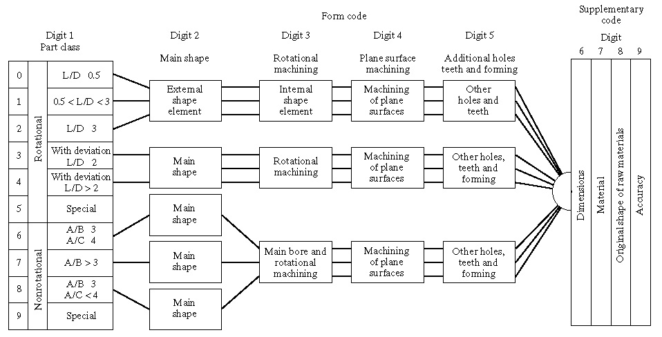
Basic Structure of Opitz System
©2008 Pearson Education, Inc., Upper Saddle River, NJ. All rights reserved. This material is protected under all copyright laws as they currently exist.
No portion of this material may be reproduced, in any form or by any means, without permission in writing from the publisher. For the exclusive use of adopters of the book
Automation, Production Systems, and Computer-Integrated Manufacturing, Third Edition, by Mikell P. Groover.

Slide 20
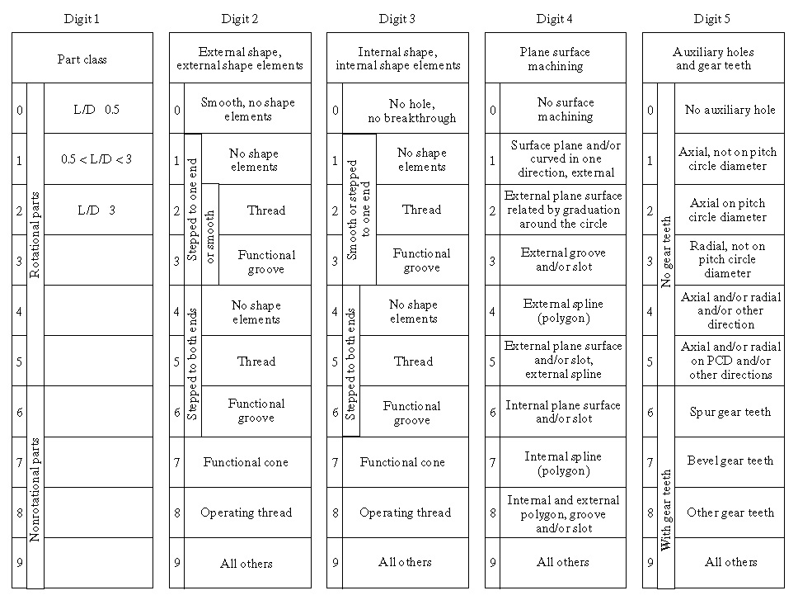
Opitz Form Code (Digits 1 through 5)
©2008 Pearson Education, Inc., Upper Saddle River, NJ. All rights reserved. This material is protected under all copyright laws as they currently exist.
No portion of this material may be reproduced, in any form or by any means, without permission in writing from the publisher. For the exclusive use of adopters of the book
Automation, Production Systems, and Computer-Integrated Manufacturing, Third Edition, by Mikell P. Groover.

Slide 21
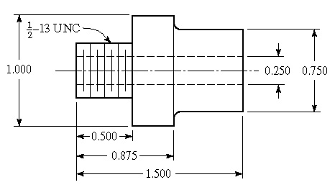
Example: Opitz Form Code
Form code in Opitz system is 15100
©2008 Pearson Education, Inc., Upper Saddle River, NJ. All rights reserved. This material is protected under all copyright laws as they currently exist.
No portion of this material may be reproduced, in any form or by any means, without permission in writing from the publisher. For the exclusive use of adopters of the book
Automation, Production Systems, and Computer-Integrated Manufacturing, Third Edition, by Mikell P. Groover.

Slide 22
Production Flow Analysis (PFA)
Method for identifying part families and associated machine groupings based on production route sheets rather than part design data
Workparts with identical or similar route sheets are classified into part families
Advantages of using route sheet data
  Parts with different geometries may nevertheless require the same or similar processing
  Parts with nearly the same geometries may nevertheless require different processing
©2008 Pearson Education, Inc., Upper Saddle River, NJ. All rights reserved. This material is protected under all copyright laws as they currently exist.
No portion of this material may be reproduced, in any form or by any means, without permission in writing from the publisher. For the exclusive use of adopters of the book
Automation, Production Systems, and Computer-Integrated Manufacturing, Third Edition, by Mikell P. Groover.

Slide 23
Steps in Production Flow Analysis
Data collection – operation sequence and machine routing for each part
Sortation of process routings – parts with same sequences and routings are arranged into “packs”
PFA chart – each pack is displayed on a PFA chart
  Also called a part-machine incidence matrix
Cluster analysis – purpose is to collect packs with similar routings into groups
  Each machine group = a machine cell
©2008 Pearson Education, Inc., Upper Saddle River, NJ. All rights reserved. This material is protected under all copyright laws as they currently exist.
No portion of this material may be reproduced, in any form or by any means, without permission in writing from the publisher. For the exclusive use of adopters of the book
Automation, Production Systems, and Computer-Integrated Manufacturing, Third Edition, by Mikell P. Groover.

Slide 24
Cellular Manufacturing
Application of group technology in which dissimilar machines or processes are aggregated into cells, each of which is dedicated to the production of a part family or limited group of families
Typical objectives of cellular manufacturing:
  To shorten manufacturing lead times
  To reduce WIP
  To improve quality
  To simplify production scheduling
  To reduce setup times
©2008 Pearson Education, Inc., Upper Saddle River, NJ. All rights reserved. This material is protected under all copyright laws as they currently exist.
No portion of this material may be reproduced, in any form or by any means, without permission in writing from the publisher. For the exclusive use of adopters of the book
Automation, Production Systems, and Computer-Integrated Manufacturing, Third Edition, by Mikell P. Groover.

Slide 25
Composite Part Concept
A composite part for a given family is a hypothetical part that includes all of the design and manufacturing attributes of the family
In general, an individual part in the family will have some of the features of the family, but not all of them
A production cell for the part family would consist of those machines required to make the composite part
Such a cell would be able to produce any family member, by omitting operations corresponding to features not possessed by that part
©2008 Pearson Education, Inc., Upper Saddle River, NJ. All rights reserved. This material is protected under all copyright laws as they currently exist.
No portion of this material may be reproduced, in any form or by any means, without permission in writing from the publisher. For the exclusive use of adopters of the book
Automation, Production Systems, and Computer-Integrated Manufacturing, Third Edition, by Mikell P. Groover.

Slide 26
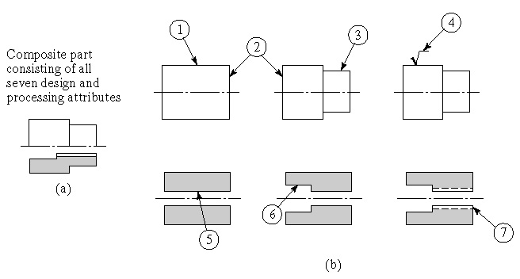
Composite Part Concept
Composite part concept: (a) the composite part for a family of machined rotational parts, and (b) the individual features of the composite part
©2008 Pearson Education, Inc., Upper Saddle River, NJ. All rights reserved. This material is protected under all copyright laws as they currently exist.
No portion of this material may be reproduced, in any form or by any means, without permission in writing from the publisher. For the exclusive use of adopters of the book
Automation, Production Systems, and Computer-Integrated Manufacturing, Third Edition, by Mikell P. Groover.

Slide 27
Part Features and Corresponding Manufacturing Operations
Design feature Corresponding operation
External cylinder Turning
Face of cylinder Facing
Cylindrical step Turning
Smooth surface External cylindrical grinding
Axial hole Drilling
Counter bore Counterboring
Internal threads Tapping
©2008 Pearson Education, Inc., Upper Saddle River, NJ. All rights reserved. This material is protected under all copyright laws as they currently exist.
No portion of this material may be reproduced, in any form or by any means, without permission in writing from the publisher. For the exclusive use of adopters of the book
Automation, Production Systems, and Computer-Integrated Manufacturing, Third Edition, by Mikell P. Groover.

Slide 28
Machine Cell Designs
Single machine
Multiple machines with manual handling
  Often organized into U-shaped layout
Multiple machines with semi-integrated handling
Automated cell – automated processing and integrated handling
  Flexible manufacturing cell
  Flexible manufacturing system
©2008 Pearson Education, Inc., Upper Saddle River, NJ. All rights reserved. This material is protected under all copyright laws as they currently exist.
No portion of this material may be reproduced, in any form or by any means, without permission in writing from the publisher. For the exclusive use of adopters of the book
Automation, Production Systems, and Computer-Integrated Manufacturing, Third Edition, by Mikell P. Groover.

Slide 29
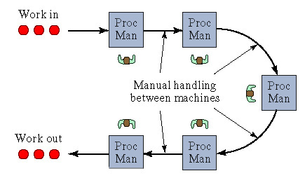
Machine Cell with Manual Handling
U-shaped machine cell with manual part handling between machines
©2008 Pearson Education, Inc., Upper Saddle River, NJ. All rights reserved. This material is protected under all copyright laws as they currently exist.
No portion of this material may be reproduced, in any form or by any means, without permission in writing from the publisher. For the exclusive use of adopters of the book
Automation, Production Systems, and Computer-Integrated Manufacturing, Third Edition, by Mikell P. Groover.

Slide 30
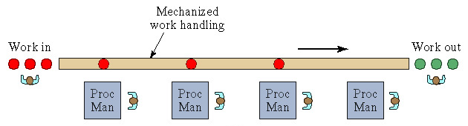
Cell with Semi-Integrated Handling
In-line layout using mechanized work handling between machines
©2008 Pearson Education, Inc., Upper Saddle River, NJ. All rights reserved. This material is protected under all copyright laws as they currently exist.
No portion of this material may be reproduced, in any form or by any means, without permission in writing from the publisher. For the exclusive use of adopters of the book
Automation, Production Systems, and Computer-Integrated Manufacturing, Third Edition, by Mikell P. Groover.

Slide 31
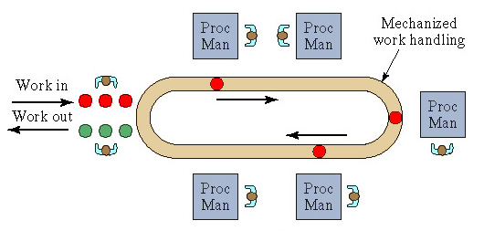
Cell with Semi-Integrated Handling
Loop layout allows variations in part routing between machines
©2008 Pearson Education, Inc., Upper Saddle River, NJ. All rights reserved. This material is protected under all copyright laws as they currently exist.
No portion of this material may be reproduced, in any form or by any means, without permission in writing from the publisher. For the exclusive use of adopters of the book
Automation, Production Systems, and Computer-Integrated Manufacturing, Third Edition, by Mikell P. Groover.

Slide 32
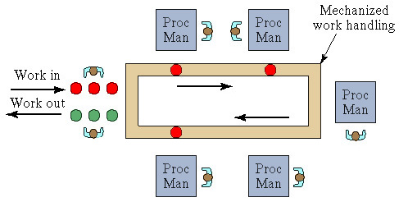
Cell with Semi-Integrated Handling
Rectangular layout also allows variations in part routing and allows for return of work carriers if they are used
©2008 Pearson Education, Inc., Upper Saddle River, NJ. All rights reserved. This material is protected under all copyright laws as they currently exist.
No portion of this material may be reproduced, in any form or by any means, without permission in writing from the publisher. For the exclusive use of adopters of the book
Automation, Production Systems, and Computer-Integrated Manufacturing, Third Edition, by Mikell P. Groover.

Slide 33
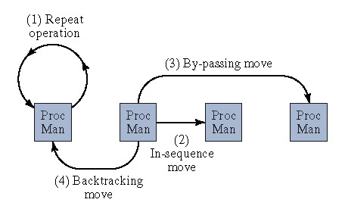
Four Types of Part Moves in
Mixed Model Production System
©2008 Pearson Education, Inc., Upper Saddle River, NJ. All rights reserved. This material is protected under all copyright laws as they currently exist.
No portion of this material may be reproduced, in any form or by any means, without permission in writing from the publisher. For the exclusive use of adopters of the book
Automation, Production Systems, and Computer-Integrated Manufacturing, Third Edition, by Mikell P. Groover.

Slide 34
Key Machine Concept
Applies in cells when there is one machine (the key machine) that is more expensive or performs certain critical operations
  Other machines in the cell are supporting machines
  Important to maintain high utilization of key machine, even if this means lower utilization of supporting machines
©2008 Pearson Education, Inc., Upper Saddle River, NJ. All rights reserved. This material is protected under all copyright laws as they currently exist.
No portion of this material may be reproduced, in any form or by any means, without permission in writing from the publisher. For the exclusive use of adopters of the book
Automation, Production Systems, and Computer-Integrated Manufacturing, Third Edition, by Mikell P. Groover.

Slide 35
Manufacturing Applications of Group Technology
Different ways of forming machine cells:
  Informal scheduling and routing of similar parts through selected machines to minimize setups
  Virtual machine cells – dedication of certain machines in the factory to produce part families, but no physical relocation of machines
  Formal machine cells – machines are physically relocated to form the cells
Automated process planning
Modular fixtures
Parametric programming in NC
©2008 Pearson Education, Inc., Upper Saddle River, NJ. All rights reserved. This material is protected under all copyright laws as they currently exist.
No portion of this material may be reproduced, in any form or by any means, without permission in writing from the publisher. For the exclusive use of adopters of the book
Automation, Production Systems, and Computer-Integrated Manufacturing, Third Edition, by Mikell P. Groover.

Slide 36
Benefits of Group Technology in Manufacturing
Standardization of tooling, fixtures, and setups is encouraged
Material handling is reduced
  Parts are moved within a machine cell rather than the entire factory
Process planning and production scheduling are simplified
Work‑in‑process and manufacturing lead time are reduced
Improved worker satisfaction in a GT cell
Higher quality work
©2008 Pearson Education, Inc., Upper Saddle River, NJ. All rights reserved. This material is protected under all copyright laws as they currently exist.
No portion of this material may be reproduced, in any form or by any means, without permission in writing from the publisher. For the exclusive use of adopters of the book
Automation, Production Systems, and Computer-Integrated Manufacturing, Third Edition, by Mikell P. Groover.

Slide 37
Product Design Applications of Group Technology
Design retrieval systems
  Industry survey: For new part designs,
    Existing part design could be used - 20%
    Existing part design with modifications – 40%
    New part design required – 40%
Simplification and standardization of design parameters such as tolerances, chamfers, hole sizes, thread sizes, etc.
  Reduces tooling and fastener requirements in manufacturing
©2008 Pearson Education, Inc., Upper Saddle River, NJ. All rights reserved. This material is protected under all copyright laws as they currently exist.
No portion of this material may be reproduced, in any form or by any means, without permission in writing from the publisher. For the exclusive use of adopters of the book
Automation, Production Systems, and Computer-Integrated Manufacturing, Third Edition, by Mikell P. Groover.

